Slide 1
Executive Budget Fiscal Year 2022-2023 Senate Finance Committee February 22, 2022
John Bel Edwards
Governor

Slide 2
Four things come not back: the spoken word, the sped arrow, the past life and the neglected opportunity. —Arabian proverb

Slide 3
We are Tough.
We are Resilient.
We are Optimistic.

Slide 4
Be Happy.
Be Disciplined.
Be Smart.

Slide 5
The Opportunity: Sources of One-Time Funding
American Rescue Plan | $1.4 billion
FY 21 Surplus | $700 million
FY 22 Projected Excess | $853 million
TOTAL | $2.83 billion

Slide 6
Money
Do Things

Slide 7
American Rescue Plan
Louisiana received $3.011 billion in Fiscal Year 2021
Funds appropriated and transferred — $1.626 billion
Recommendations for remainder of funds — $1.384 billion
Unemployment Insurance Fund — $550 million
Transportation Projects — $275 million
Water/sewer projects — $559 million

Slide 8
Transportation Projects
Lake Charles I-10 Bridge | $100 million
I-49 South | $100 million
DOTD Opportunity Fund | $50 million
Baton Rouge/New Orleans Rail | $25 million
Total | $275 million

Slide 9
Water Sector Fund
81 Water Projects | $193 million | 65%
35 Sewer Projects | $104 million | 35%
116 Projects | $297 million
$559 million reserved for second traunch

Slide 10
FY 21 Surplus $700 Million

Slide 11
Recommendation for Surplus Dollars
25% | Budget Stabilization Fund (Rainy Day) | $175 M
10% | Unfunded Accrued Liability (UAL) | $70 M
 | DOTD Highway Program
 | Matching Funds for Redistribution | $25 M
 | FY23 Match for Infrastructure (IIJA) | $171 M
 | CPRA Master Plan Project | $150 M
 | Capital Outlay – Deferred Maintenance | $109 M

Slide 12
Projected Balance
$721 Million
*Includes anticipated deposit of $174.8 million of FY21 Surplus.

Slide 13
FY 22 Excess

Slide 14
Revised Revenue Estimates for FY 2021-2022
 | Prior Forecast May 18, 2021 | Revised Official Forecast January 11, 2022
Taxes, Licenses & Fees | $12,296.3 | $13,869.0
Dedications | ($2,408.7) | ($3,134.1)
State General Fund Direct | $9,887.6 | $10,735.0
In Millions
Official forecast increased state general fund direct by $847.4 million

Slide 15
FY 22 Recommendations for Supplemental and Funds Bills

Slide 16
FY 2021-2022 Supplemental and Funds Bills
$400 million for the Hurricane Storm Damage and Risk Reduction System second payment to Corps of Engineers
In excess of $450 million for FEMA repayments for cost share obligations for storms dating back to Katrina
Deposits into the Early Childhood fund based on current year savings in DOE due to lower student count – approx. $50 million
$42.5 million to DOTD for IIJA match
$500 million deposit into a new fund for a new Mississippi River Bridge

Slide 17
FY 2021-2022 Supplemental and Funds Bills
$1.5 million – Northwest LA Crime Lab
$3 million – Death benefits for the Military
$5 million – NCAA Final Four this March
$6.9 million--LWIN transition to Ethernet and new generators
$10 million – Louisiana Outdoors Forever Fund
$16.7 million – Corrections and Public Safety
$65 million – Judgments
$65 million – Cash capital outlay projects

Slide 18
Investing in Roads and Bridges
FY 21 State General Fund Surplus
FY 23 – Match for existing identified projects | $170.6 million
FY 23 – Match for August redistribution | $25.0 million
Total FY 21 SGF Surplus | $195.6 million
FY 22 State General Fund Excess
F Y22 – Match for existing identified projects, redistribution and competitive IIJA grants | $42.5 million
New Baton Rouge Bridge Fund | $500.0 million
Total FY 22 SGF Excess | $542.5 million
American Rescue Plan
Lake Charles Bridge | $100.0 million
Baton Rouge to New Orleans Rail | $25.0 million
Opportunity/Contingency Fund – Competitive grants, opportunities and cost overruns | $50.0 million
Total American Rescue Plan | $275.0 million
Total Additional Funding for DOTD | $1,031.1 billion

Slide 19
FY 22 Accomplishments

Slide 20
Louisiana Annual Gross Domestic Product (GDP): 2009-2021
In Billions

Slide 21
Louisiana Unemployment Rate

Slide 22
Rating Agency Review
Moody’s Rating Agency, January 12, 2022
Louisiana’s positive outlook reflects the significant progress the state has made restoring its financial reserves in recent years by aligning revenue and spending in a post-energy boom era, rebuilding liquidity and generating budgetary surpluses. The state’s recovery, however, depends in part on the recovery of New Orleans (A2 stable), the state’s largest city and a popular tourism destination.
Factors that could lead to an upgrade include: long-term growth and diversification of the state economy that offset the volatility of the energy sector as well as sustained trend of structural budget balance with continued strengthening of reserves and liquidity.

Slide 23
New Economic Activity and Investment
Year | Number of Project Wins | Capital Investment | New Direct and Indirect Jobs | Retained Jobs
2016 | 36 | $22.15 billion | 6,908 | 4,807
2017 | 45 | $4.64 billion | 13,964 | 7,987
2018 | 47 | $6.73 billion | 7,188 | 8,095
2019 | 83 | $8.45 billion | 12,331 | 15,581
2020 | 58 | $12.7 billion | 11,632 | 8,692
2021 | 63 | $20.56 billion | 17,802 | 17,665
Total | 332 | $75.2 billion | 69,825 | 62,827

Slide 24
DOTD Accomplishments
Projects Let January 2016 through December 10, 2021
Number of projects let: 1,790
Total Cost: $4,492,807,888
Miles of road affected: 5,947
For State FY 20-21, from July 2020 through June 2021, DOTD took bids on 236 projects with a total letting value of $618 million. The Agency received $65 million in federal re-distributed funds in August 2021, which were immediately obligated toward new construction projects.
COVID Relief Funding
Over $17M in Federal COVID relief funding for non-urban transits.
An additional $174 million in COVID Relief (CRRSA) funds that can be used on, but not limited to, highways, bridges, and ferries to perform routine and preventive maintenance, rehabilitation, and overlays on new and existing roadways throughout the state.
DOTD was appropriated $563 million of ARPA funding in FY 22.

Slide 25
Mississippi River Deepening
The total cost estimate of the River Deepening Project with utility relocation is approximately $262.28 million
Federal Sources: $175 million
State Sources: $86 million
Other: $2 million
SW pass deepening is complete. USACE currently validating the depth of the utilities at the mouth of the River and Rich Bend.
Phase 2 — utility relocation
Phase 3 is deepening between New Orleans and Baton Rouge and cannot be completed until Phase 2 is completed

Slide 26
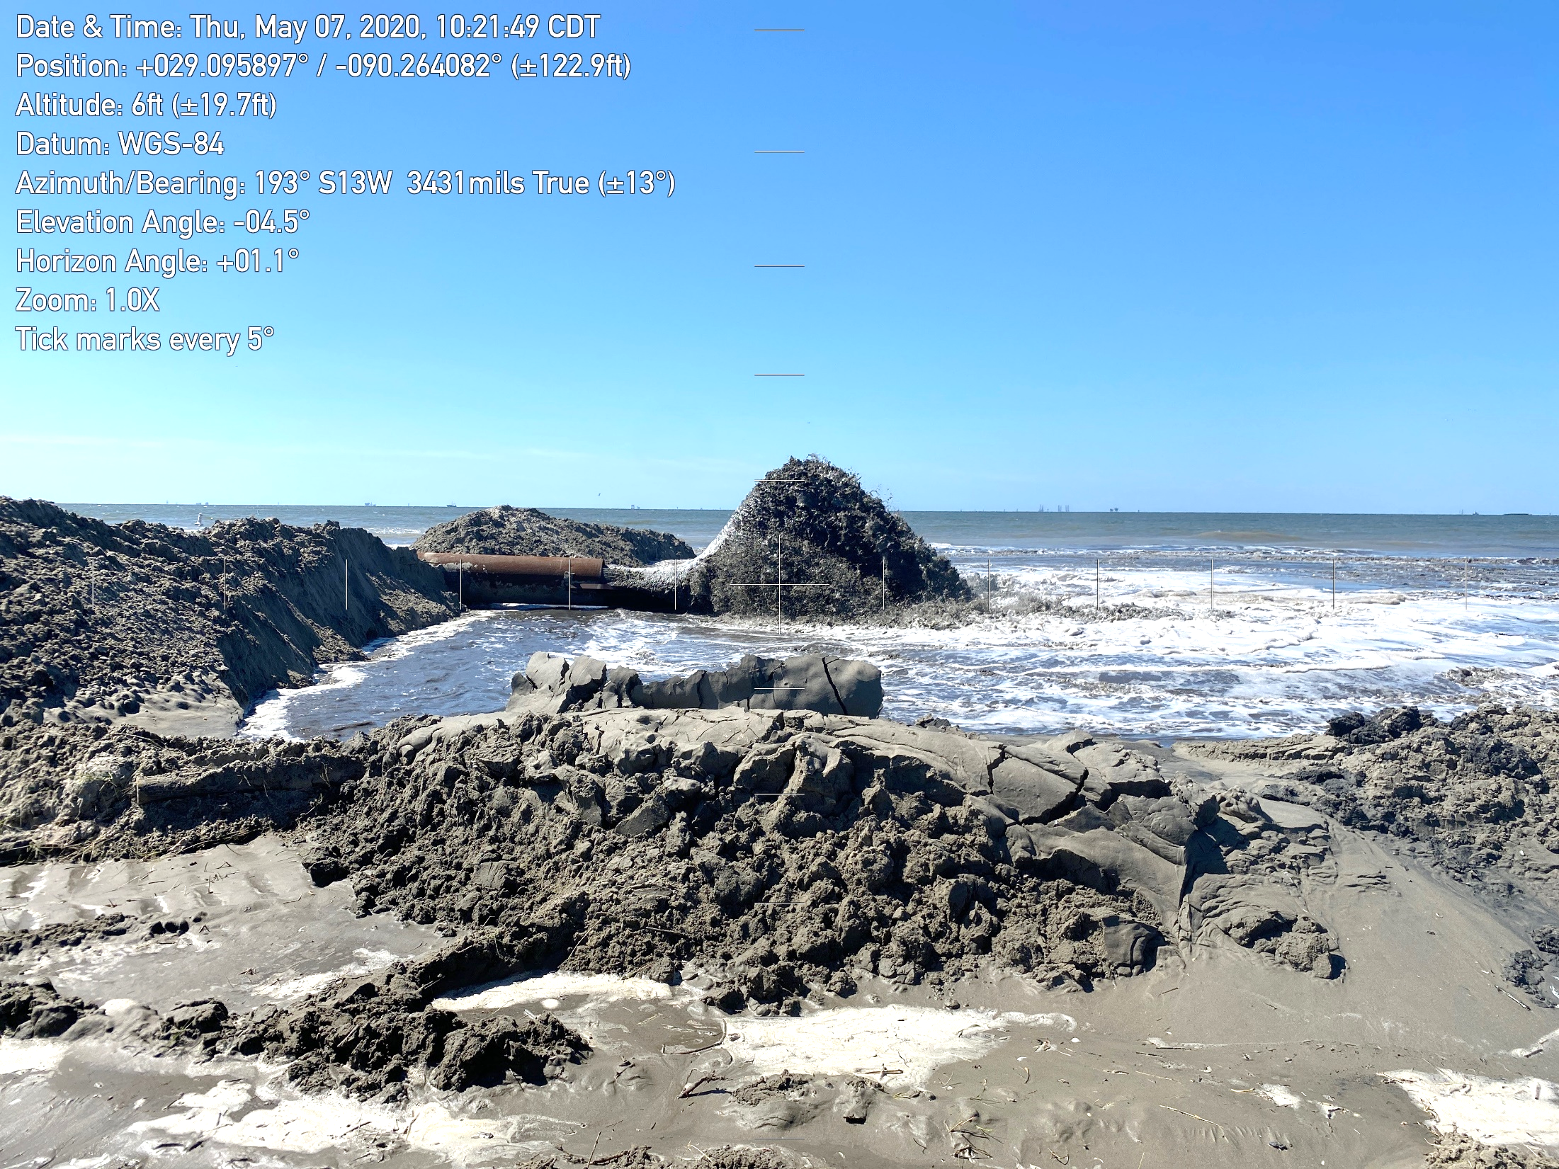
2021 IN REVIEW: 47 Projects in Construction
15 New Construction Starts:
13 Projects Completed:
Miles of Levees Improved:
Sediment Dredged:
Acres Created:
$978 Million Total Value
$258 Million Total Value
18+ miles
11.4 Million Cubic Yards
(65 Million CY Total Vol.)
1,923 acres (3 square miles)
MAJOR PROJECT ANNOUNCEMENTS, INCLUDING:
HNC Lock Complex – Groundbreaking ($358 Million RESTORE)
Terrebonne Basin Barrier Islands – Completion of Trinity ($170 Million NFWF)
West Shore Lake Pontchartrain – Construction Start ($760 Million USACE/State)
Spanish Pass, Golden Triangle, Lake Borgne – Construction Start
($257 Million NRDA)

Slide 27
Supporting the Health Care Surge
 | 2020 – Spring, Summer, & Fall Completers | 2021 – Spring, Summer, & Fall Completers | Total - Health Care Support since the Beginning of the Pandemic
Health care graduates finishing early or on-time in Louisiana public and private institutions, including: | 7,500 | 5,000 | 12,500
Medical and pharmacy degrees | 719 | 437 | 1,156
Certificate/technical diplomas (e.g. EMT, LPN) | 2,109 | 719 | 2,828
Associate degrees (e.g. respiratory care therapist, nursing, occupational and physical therapy assistant) | 1,156 | 780 | 1,936
Bachelor’s degrees (e.g. allied health, registered nurse) | 1,601 | 2240 | 3,841
Master, doctoral, and professional degrees (e.g. nurse practitioner, physical therapy) | 809 | 724 | 1,533

Slide 28
K-12 Education
From catastrophic hurricanes to a global pandemic, Louisiana faced extraordinary obstacles in 2021. Nonetheless, Louisiana students, teachers, administrators, and parents have shown unwavering resilience every single day.
Thanks to their hard work, LDOE has been able to implement the third most aggressive return to school plan in the United States, according to the American Enterprise Institute.
$25 million in new State General Fund to Early Childhood to assist with rate changes.

Slide 29
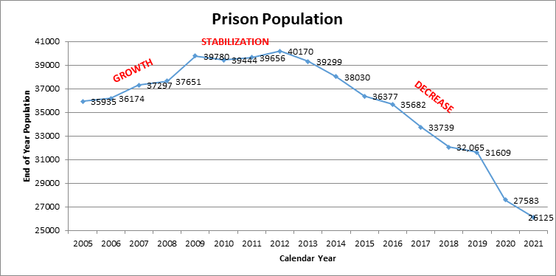

Slide 30
FY 2022-2023 Executive Budget

Slide 31
Revised Revenue Estimates for FY 2022-2023
 | Forecast May 18, 2021 | Official Forecast January 11, 2022
Taxes, Licenses & Fees | $12,610.1 | $13,573.1
Dedications | ($2,445.7) | ($2,637.3)
State General Fund Direct | $10,164.4 | $10,935.8
In Millions
Official forecast increased state general fund direct by $771.4 million

Slide 32
Revenue Outlook Before Pandemic and Now: Taxes, Licenses and Fees
January 11, 2022
January 31, 2020
January 19, 2021

Slide 33
FY 2021-2022 Budget Comparisons
 | FY 2021-2022 Existing Operating Budget | FY 2022-2023 Executive Budget | Over/Under Budgeted
General Fund | $10,066.9 | $10,935.8 | $868.9
Fees/Self- Generated | $3,374.7 | $3,531.6 | $156.9
Statutory Dedications | $6,457.4 | $4,480.0 | ($1,977.4)
Federal Funds | $20,330.9 | $19,690.7 | ($640.2)
Total | $40,229.9 | $38,638.1 | ($1,591.8)
In
Millions
Exclusive of double counts

Slide 34
General Fund Budget
Executive Budget
General Fund Budgeted July 1

Slide 35
State General Fund

Slide 36
FY 2022-2023 Executive Budget
Investing in the Future with No One-Time Money
Major Increases | General Fund
Replacement of one-time funds | $671.2
K-12 Teacher Pay Increases @ $1,500/$750 | $148.4
Higher Education faculty pay increase, statewide costs | $103.9
Acquisitions and major repairs | $36.8
LDH equalizing rates for Personal Care Services | $33.8
Supplemental Pay increases @$100 | $25.7
Early Childhood — rate and accessibility increases | $25.0
In Millions

Slide 37
General Fund Investment
Replacement of one-time funds for emergency FMAP and Lottery — $671.2 million
Budgeting for the lower blended FMAP rate for FY 23 — $67.4 million
Providing funds for state agency acquisitions and repairs — $36.8 million

Slide 38
General Fund Investment
Department of Education
Minimum Foundation Program is fully funded
Student count during FY 2023 is currently projected to have a small increase over current year
$148.4 million for teacher and support worker pay raise
$25 million for early childhood rate and accessibility increases approved by BESE January 18, 2022

Slide 39
General Fund Investment
Early Childhood Education
Working closely with DOE to maximize productivity
Increase per child rate to providers $25 million
Increase LA4 rate per pupil $17 million
Increase rate for Nonpublic School Early Childhood Development (NSECD) $1.4 million
Add additional funding for 256 students on waitlist for Student Scholarship For Education Excellence Program (SSEBP) $4.1 million
NOTE: In FY 22, $25 million DOE funding redirected from MFP (due to lower student count) to Early Childhood Fund, which creates matching dollars for local district support $25 million

Slide 40
General Fund Investment
Higher Education
Faculty Pay increase/related benefits $31.7 million
Mandated cost increases and LSU First $18.0 million
Formula funding $25.0 million
Go Grants $15.0 million
Title IX offices $5.0 million
Pennington youth obesity pilot program $5.0 million
LSU and SU Ag programs $4.1 million

Slide 41
Higher Education

Slide 42
Higher Education

Slide 43
Louisiana Department of Health
General Fund is increased by $546.6 million, MATF fund decreased by $232.4 million, and federal funds decreased by $314.1 million.
There is no Public Health Emergency (PHE) enhanced rate built into the budget for FY 23.
Directed Payment model is NOT included at this time. LDH is currently communicating with CMS.

Slide 44
Medical Vendor Payments & OBH Rate Increases
Requested by ARC and Community Provider Association
Item | Requested by Advocates | Funded
Raise LT-PCS and Community Choices rates (brings rate to $18.50/hour) | $33.9 Million | $33.9 Million
ICF rebase – includes $12 add-on for employee retention (brings per diem to $220.66) | $8.3 Million | $7.75 Million
Annualize rate increase for DD waivers (raised $2.50/hour to $18.50/hour in FY22 | $6.8 Million NOW Fund | $6.8 Million NOW Fund
Support Coordination rate increase (not reimbursed on a per hour basis) | $3.3 Million | $0
Transportation services for DD individuals | $1.5 Million | $0
Notes:
.

Slide 45
Medical Vendor Payments & OBH Rate Increases
Requested by LDH
Item | Requested | Funded
Nursing Home per diem add-on for employee retention ($4/day) | $7.6 Million | $7.6 Million
Harmony per diem increase (from $105 to $175) | $2.6 Million | $2.6 Million
Grace per diem increase (from $108 to $180) | $1.2 Million | $1.2 Million
Additional amount for 58 beds being added in FY 23 | $1.5 Million | $1.5 Million

Slide 46
Medical Vendor Payments

Slide 47
Department of Children & Family Services
Personal Services and IT System Projects
No vacancies were eliminated in the Executive Budget
System Projects includes a total of $12.6 million for the Comprehensive Child Welfare Information System (CCWIS)
Includes $10.5 million for the conversion of the current OnBase Repository System to FileNet, which is a larger electronic document management system
Includes $8.4 million for the Child Support Enforcement (CSE) Modernization Project to transition into the second phase, which will improve the operations for the CSE program beginning 4/1/23

Slide 48
Conservation Fund

Slide 49
Office of Technology Services
Modernization Update
HCR 121 of the 2017 Regular Session identified 157 IT systems at operational risk with a projected replacement cost of $1 billion
31 systems have been completed reducing backlog by $375 million
50 systems are currently in process and will reduce backlog by $400 million

Slide 50
Office of Technology Services
LaGov Update
All eligible state organizations have been implemented in LaGov for expenditure accounting, procurement, asset management, real estate, inventory, and fleet management
Statewide implementation of revenue management, and operating budget development for the remaining 4 agencies is in process
Implementation of the Capital Outlay Budget development is in process

Slide 51
Office of Technology Services
ESF 17 (Cyber) Update
ESF 17 responded to and assisted in the restoration of services for 12 local government entities in 2021
ESF 17 installed and configured premium endpoint detection and response software for approximately 50 public entities in 2021
OTS strategically partners with the Louisiana National Guard and Louisiana State Police cyber resources to create and operationally embed agency centers of cyber excellence for infrastructure assessments and forensic investigation

Slide 52
Broadband
$711 million in total project costs
$440 million in GUMBO grant funding requests (Round 1)
215,000 households proposed to be served
58 of 64 parishes
$90 million to be awarded in March
14,000 businesses proposed to be served
167 applications
58 parishes represented
23 companies
$90 million available for Round 2 opening in early summer

Slide 53
Comparison of State General Fund at EOB Freeze to Recommended
(Exclusive of Contingencies and Inclusive of Double Counts)
Department Name | EOB Freeze 12/1/2021 | Executive Budget | Recommended Over/(Under) EOB Freeze | Percent Change
Executive | 202,177,419 | 178,599,140 | (23,578,279) | (11.66%)
Veterans Affairs | 13,106,602 | 13,982,883 | 876,281 | 6.69%
Secretary of State | 56,922,580 | 63,663,715 | 6,741,135 | 11.84%
Attorney General | 16,759,976 | 15,332,745 | (1,427,231) | (8.52%)
Lieutenant Governor | 1,094,165 | 2,844,088 | 1,749,923 | 159.93%
State Treasurer | 90,000 | - | (90,000) | (100.00%)
Public Service Commission | - | - | - | 0.00%
Agriculture & Forestry | 19,723,864 | 24,140,486 | 4,416,622 | 22.39%
Commissioner of Insurance | - | - | - | 0.00%
Economic Development | 44,235,921 | 38,545,648 | (5,690,273) | (12.86%)
Culture, Recreation & Tourism | 35,815,256 | 35,251,420 | (563,836) | (1.57%)
Transportation & Development | 16,150,000 | 5,000,000 | (11,150,000) | (69.04%)
Corrections Services | 562,077,172 | 629,648,552 | 67,571,380 | 12.02%
Public Safety Services | 4,101,659 | 2,894,000 | (1,207,659) | (29.44%)
Youth Services | 130,395,033 | 138,368,190 | 7,973,157 | 6.11%
Health & Hospitals | 2,349,184,553 | 2,828,697,630 | 479,513,077 | 20.41%
Children & Family Services | 223,588,005 | 249,463,416 | 25,875,411 | 11.57%
Natural Resources | 7,933,771 | 10,584,407 | 2,650,636 | 33.41%
Revenue | - | - | - | 0.00%
Environmental Quality | 3,529,624 | 4,568,830 | 1,039,206 | 29.44%

Slide 54
Comparison of State General Fund at EOB Freeze to Recommended
(Exclusive of Contingencies and Inclusive of Double Counts)
Department Name | EOB Freeze 12/1/2020 | Executive Budget | Recommended Over/(Under) EOB Freeze | Percent Change
Workforce Commission | 9,595,933 | 10,595,933 | 1,000,000 | 10.42%
Wildlife & Fisheries | 295,000 | 8,350,000 | 8,055,000 | 2730.51%
Civil Service | 6,146,574 | 6,818,368 | 671,794 | 10.93%
Retirement Systems | - | - | - | 0.00%
Higher Education | 1,174,941,971 | 1,250,587,272 | 75,645,301 | 6.44%
Other Education | 57,325,844 | 58,278,646 | 952,802 | 1.66%
Dept. of Education | 3,660,845,184 | 3,933,285,471 | 272,440,287 | 7.44%
Health Care Services Division | 24,983,780 | 25,530,111 | 546,331 | 2.19%
Other Requirements | 639,619,047 | 628,514,802 | (11,123,701) | (1.74%)
General App. Bill | $9,260,638,933 | $10,163,545,753 | $902,887,364 | 9.75%
Ancillary | - | - | - | 0.00%
Non-Appropriated | 525,352,685 | 526,904,967 | 1,552,282 | 0.30%
Judicial App. Bill | 164,008,439 | 171,739,107 | 7,730,668 | 4.71%
Leg. App. Bill | 73,610,173 | 73,610,173 | - | 0.00%
Special Acts | - | - | - | 0.00%
Capital Outlay | 43,331,996 | - | (43,331,996) | (100.00%)
Other App. Bills & Requirements | $806,303,293 | $772,254,247 | ($34,049,046) | (4.22%)
Total State Requirements | $10,066,942,226 | $10,935,800,000 | $868,838,318 | 8.63%

Slide 55
Seize the Moment
Don’t blow it
$2.83 billion in one-time money
Use it exclusively for one-time needs
Pay down debt
Seed the Early Childhood Education Fund
Invest $1 billion on roads, highways, and bridges
Create fund for new Baton Rouge bridge

Slide 56
Invest in FY 23
Increase teacher pay
Increase faculty pay
Commit more than $150 million in new dollars for Higher Education
Increase supplemental pay
Raise rates for all ICF/OD providers

